Slide 1
Business Analysis Skills & Competencies
Ken Fulmer
April 3, 2018

Slide 2
BABOK 3.0 - Competency Model v4

Slide 3
The Business Analyst of the Future
The business analyst of tomorrow brings more than a business or systems perspective, they represent the customer and connect solutions to their needs.
BIG-PICTURE MINDED
Holistic Solutions
CUSTOMER FOCUSED Understands the business customer
EMPATHETIC
With the customer
SKILLS
TECH SAVVY
Understands the application of technology
STRATEGIC
Examine the business model
FLEXIBLE
In the techniques that are used and artifacts produced
COLLABORATIVE
Engages all stakeholders
INNOVATIVE
Within the enterprise

Slide 4
Digital BA “hard” skills
Understand Strategic Imperatives
1
Understand Technology
Customer
Experience
7
2
FOLLOW BA BEST PRACTICES
Drive Evidence/ / Data Based Decisions
Reimagine Business Processes
6
3
Continuous Stakeholder Collaboration
Embrace Agility
5
4

Slide 5
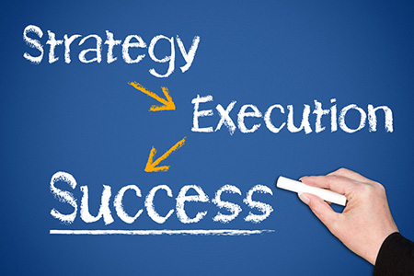
1 - Understand Strategic Imperatives
Understanding the ‘big picture’
STRATEGIC SKILLS
Business Agility
Competitive Analysis
Strategic Analysis
Strategic Leadership
Organizational Change
Value Realization
Understanding of Business Agility as a Strategy
Sustainable competitive advantage
Strategy at all levels (enterprise, function, project/program)
Strategy to Execution – key to deliver value

Slide 6
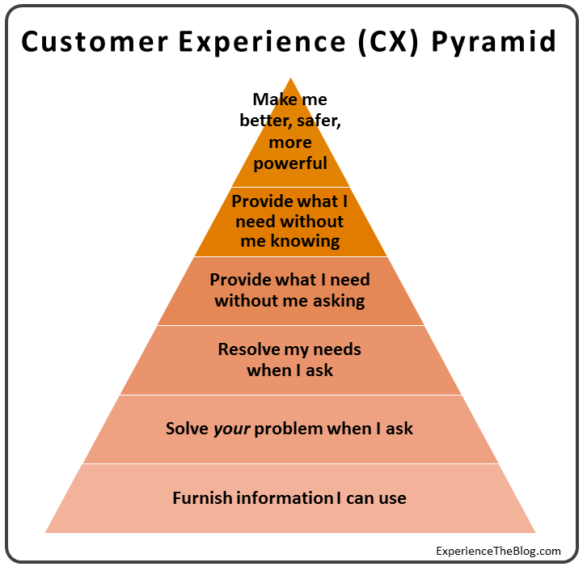
2- Customer Experience
Think from the customer perspective (“outside-in”)
Analyze Customer Journey and Map all journeys
Assess the full cycle of that customer product/service and all partners in the supply chain needed – stakeholders can cross enterprises – and often do.
When appropriate – be the proxy for the product owner and be focused on the overall set of avatars/personas that are the customer (story of Malcolm Gladwell and Spaghetti Sauce)
When appropriate – be the “Voice of the Customer”

Slide 7
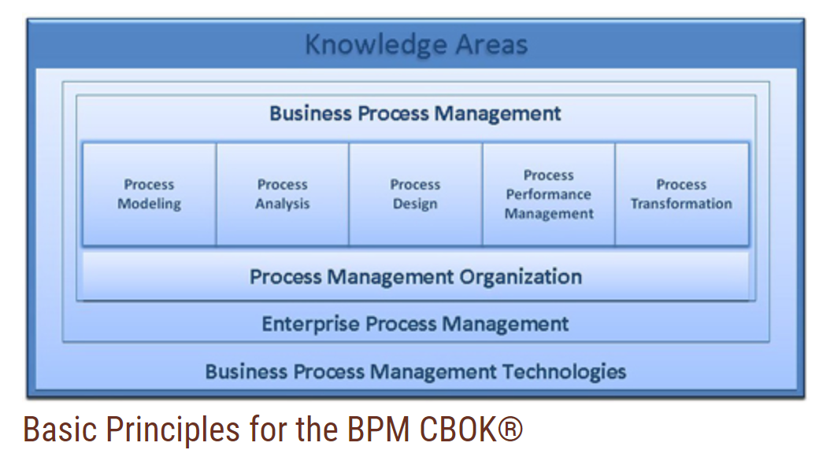
3- Business Process
Re-imagine the Business Process
Front Office – tie to customer experience
Mid and Back Office - Process integration
Leverage the Business Process Management Approach
Process Analysis (vs business organization)
Process Design
Process Performance Measurement
Process Transformation & Innovation
Consider Enterprise Process Management Level
Consider “disruptive” business models

Slide 8
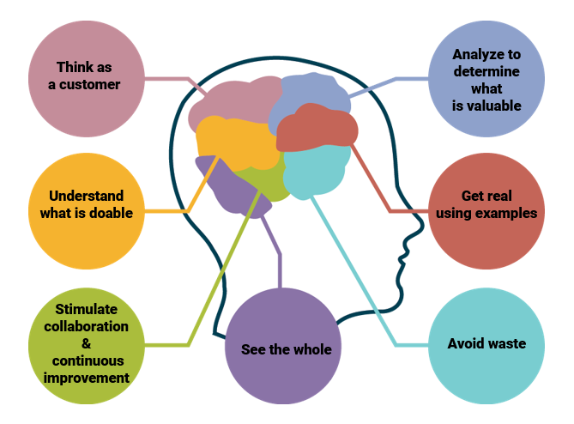
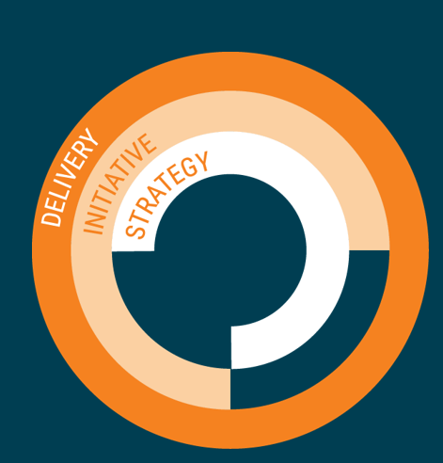
4- Embrace Agility
The Agile Mindset (not just SCRUM or Kanban methods)
deliver value rapidly and consistently,
collaborate courageously,
iterate to learn,
simplify to avoid waste,
consider the context and adapt to realities
reflect on feedback and adapt both product and process
produce the highest quality products

Slide 9
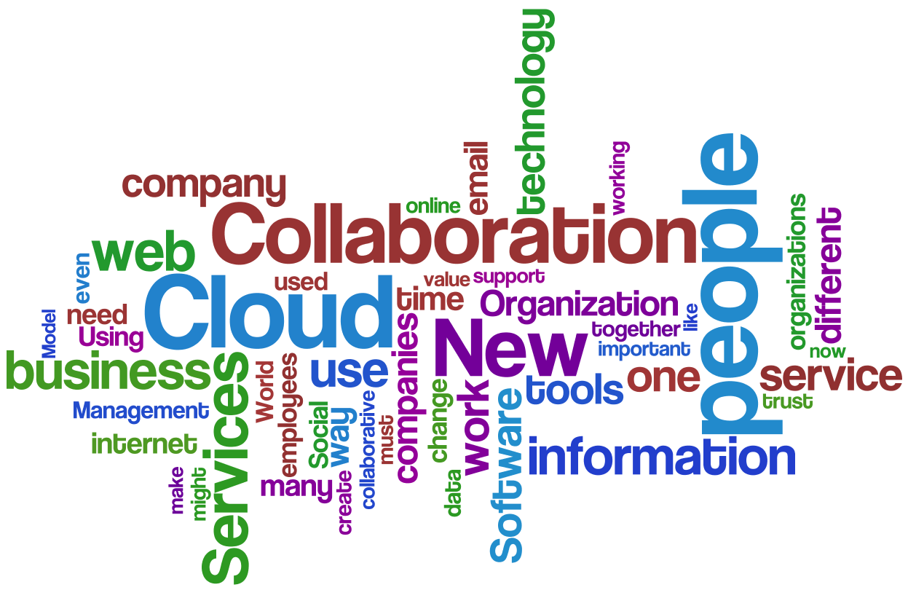
5- Continuous Stakeholder Collaboration
Stakeholders – inside and “outside”
Understanding personas
New mechanism for collaboration
Expanded concepts of Elicitation and Collaboration
More Data Centric – beyond documented conversations - measurement
More than one enterprise is typical
The importance of “continuous”
Not just a point in time –
Leadership of Collaboration and Communication

Slide 10
6 - DATA – Evidence Based Decisions
BA’s need to use data for analysis
Elicitation – survey and experience based
Customer Experience Data
“Citizen Data Scientist” Level
BA’s need to be able to use Data Tools
BA’s need to be at the “power user” not developer level for big data and business intelligence use by management
BA’s need to be able to create and interpret VISUAL data
BA’s need to interrogate data to find rules and requirement and assist in developing algorithms for AI
BA’s need to understand data structures and its business uses, and how to exploit digital marketing data

Slide 11
7 - Understand Technology
Understand how to apply Technology to achieve new business options
Understand the Technology as it applies to the industry & disruption
Understand the strategic opportunity that Technology can provide
New Business Models possible
New Business Capability – Business Architecture
Innovation and Design options available with new technology
Breakthrough Digital Concepts
Digital Analytics BlockChain Cyber Security
AI Machine Learning
Robotic Process Automation SAAS – Cloud delivery – Mobile

Slide 12
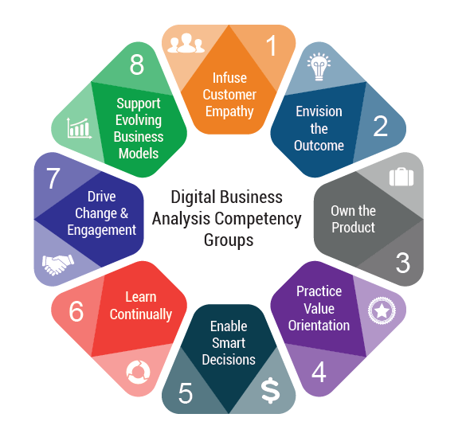
Digital BA - Professional “Soft” Skills

Slide 13
S1- Infuse Customer Empathy
Focus on the Customer
Empathy – deep understanding of Customer Experience
What the customer sees, thinks, and FEELS
Experience across the full customer journey
Human touch points – where and how does it impact the customer
Minimize touch points with automation (AI)
Think about the experience and not just the process!!

Slide 14
S2- Envision the Outcome
Creativity
Seek Unfamiliarity
Get feedback from diverse sources
Use brainstorming and personal thinking time
Understand Design thinking (Stanford ‘d’ school) & other techniques.
Innovation as a Process
From idea to prototype – filter, experiment, fail,
Improvers vs. 1st movers –
The Core often hinges on understanding the Customer Value Proposition
Focus on that outcome scenario – what is the outcome look like, why is it great?
Consider key trends, patterns, changes, and potential obstacles

Slide 15
S3- Own the product and the outcome
Product vs. Project as a concept (initiative with no specific end)
BA’s should own or lead the product & solution (not the project)
In Agile this is a role in SCRUM – apply it more broadly to any method
BA’s may act as a proxy for the business as owner (slippery approach)
Accountability still needs to be with the business – BA is collaborator
Outcome Focus
MVP product approach from the Lean Thinking (minimally viable product)
BUSINESS outcome, not project outcome (time, budget, scope)
Experiment with the value of the OUTCOME
Mindset of Leadership – ownership for the BA is critical to the profession
Create & Seize Opportunities

Slide 16
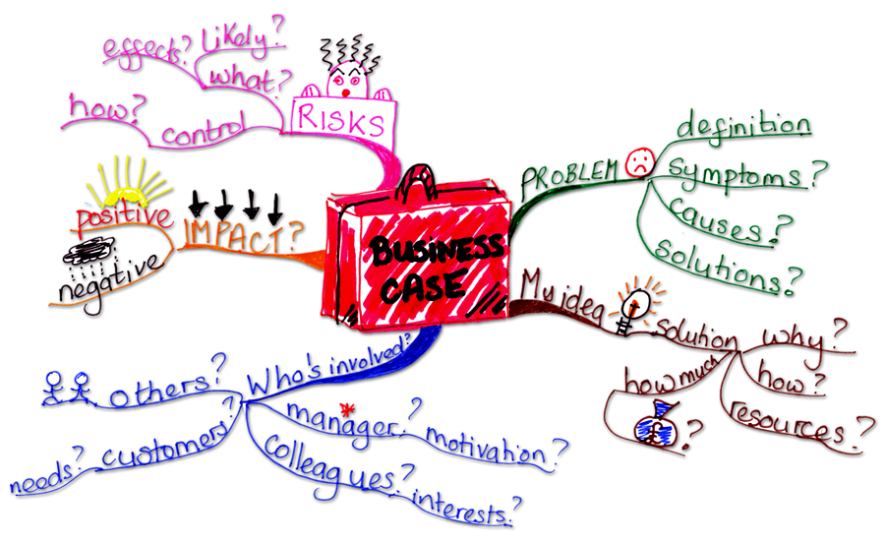
S4- Value
Seek and Analyze Value
Stakeholder conversations that establish ‘value’ – Probe for Value
Define and Prioritize Value options
Define value measures across portfolio, programs, projects
Business outcomes based on Value (aka – develop the business case)
Assist business partners communicate solution value to key stakeholders
Based on economic value, and impact of business problems or opportunities
Communicate Value
Story Telling
Benefits in credible business terms – confirmed by the business owners
Advocate for Value – not for features or functions
Progressive elaboration of value (incrementally)

Slide 17
S5 –Enable Smart Decisions
Build Decision Framework
Faster Decisions are essential to execution speed and Market pace
What Decisions – analyze core factors of what has to be decided
Decision Criteria – alternatives and options with impacts
Who Decides – establish RACI discussion and governance by issue
Consider the Stakeholders and the Human Factors
Adapt to the circumstances –
remain agile –
process feedback (learn)
Negotiate for optimal Decisions – collaborate for compromises that work

Slide 18
S6 – LEARN Continuously
Mindset of Lifetime Learning
Many things we know are enduring – Foundational skills
Other things we know are changing and are point in time skills
Industries are changing, Technology is changing, Professional roles are changing
Specialization of skills and breadth of skills are both aspects of future markets
Be a Quick Learner
Train you mind to learn quickly – accept and embrace change
Be willing to be trainable – immerse yourself in new personal career growth
Find ways to learn - just in time
New learning processes take practice (like a sport)
Look to multiple ways to find training and absorb it – multi-modal delivery
Be market opportunity driven

Slide 19
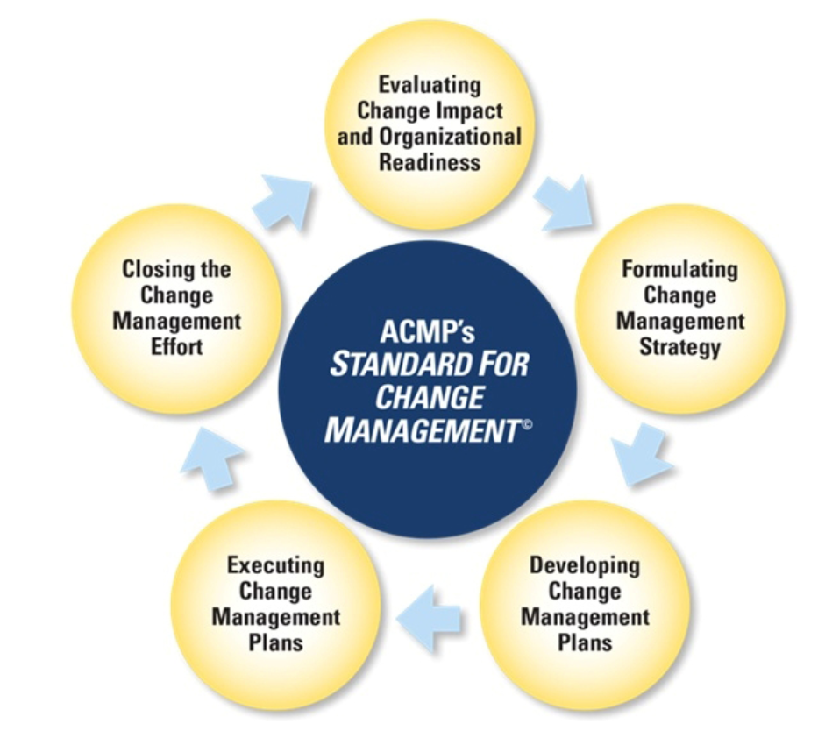
S7 – Change & Engagement
Mindset of Change Management
Not project change – organizational Change
Examine evolutionary approach to change
Change to People, Process, Technology and Data
Change from enterprise, business unit, down to work steps
Center Change objectives around Value and Customer Experience
Engagement
Buy-In from Stakeholders
Emotional IQ and Stakeholder Empathy
Harness Conflict to focus on Value
Engage with collaborative Creativity of the Solution
Make It Fun – engagement is personal
Enable Virtual engagement using technology

Slide 20
S8 – Culture & Business Models
Enterprise Culture
Culture ties to Strategy Objectives – Efficiency & Transformation
Focus on Market Awareness – Customer centricity
Obsess over Outcomes – be purposeful but tie to that Value and Outcome orientation
Enable Innovation
New Approaches
New Mindsets
Support Social Networks
Invent new Language where appropriate
Streamline the Organization Structure – flatten where possible
Business Model
Transformation drives a new culture which values innovation over efficiency
Customer Value Proposition is primary – understand horizontal segmentation & personas
Systems Thinking Mindset – Find Opportunities and Seize the Opportunity

Slide 21
Evolving Business Analysis Profession -
EXPANDED ROLE
HYBRID
Business Intelligence Analyst
BA / Product Manager
Digital BA / Product Owner
SPECIALIZED
Digital Product Manager
Security BA
RPA Analyst
STRATEGIC
Director Marketing Analysis
Chief Digital Officer
PRACTICE FUNDAMENTALS
ADVANCED SKILLS & KNOWLEDGE
BUSINESS ACUMEN & TECHNOLOGY FLUENCY
EXPANDED ROLE
DIGITAL MINDSET
Notes:
Jas

Slide 22
Micro Credentials
Combinations lead to Specializations
Specializations
Robotic Process Automation
Artificial Intelligence
Blockchain
Business Analytics
Cognitive
Machine Learning
Internet of Things
Cyber Security
AR / VR
Data Science
Connected Healthcare
FINTECH
7
Understand Technology
Technologies
so on…
so on…
Foundational Business Analysis Capabilities
(e.g. BABOK V3, Agile Extension V2 . . . )
1
Understand Strategic Imperatives
2
Empathize with real Customer
3
Reimagine Business Processes
4
Embrace Agility
5
Continuous Stakeholder Collaboration
6
Drive Evidence Based Decision
Business Domain Expertise

Slide 23
Career Architecture
Digital Skills – Hard & Soft
BABOK 3.0 – Competency
Agile Competencies
Domain Knowledge – Industry & Function
Hybrid Roles – Expanded skills
Specialty area – bundle of specific skills & technical literacy

